Slide 1
Tutorial 3 – Supplements for Lecture 3 notes

Slide 2
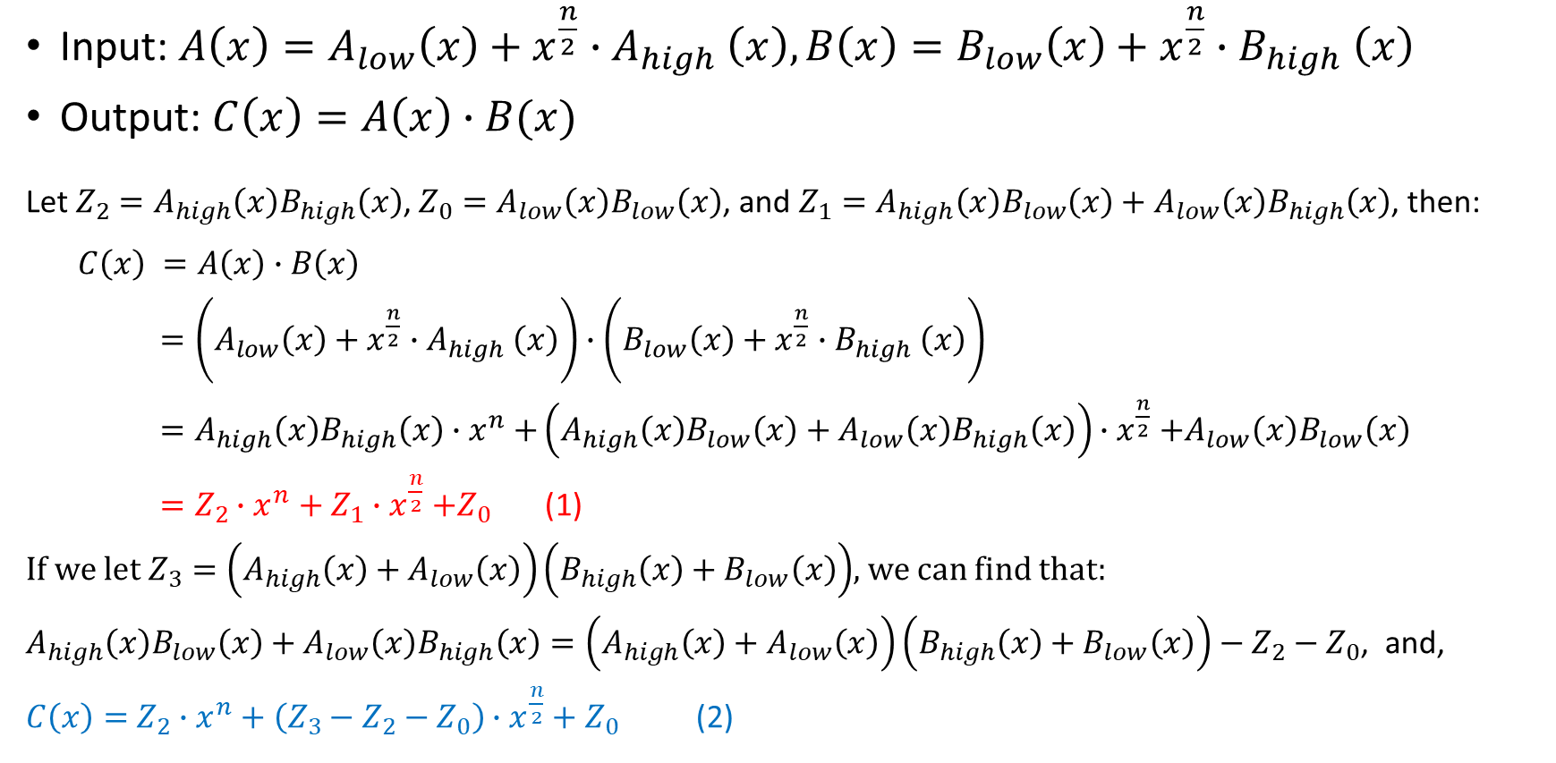
Algorithm Analysis
Input: $A\left(x\right)=A_{low}\left(x\right)+x^{\frac{n}{2}}{∙A}_{high}\left(x\right),B\left(x\right)=B_{low}\left(x\right)+x^{\frac{n}{2}}{∙B}_{high}\left(x\right)$
Output: $C\left(x\right)=A\left(x\right)∙B(x)$
Let $Z_{2}=A_{high}\left(x\right)B_{high}\left(x\right)$, $Z_{0}=A_{low}\left(x\right)B_{low}\left(x\right)$, and $Z_{1}=A_{high}\left(x\right)B_{low}\left(x\right)+A_{low}\left(x\right)B_{high}\left(x\right)$, then:
$$C\left(x\right) =A\left(x\right)∙B\left(x\right)$$
$=\left(A_{low}\left(x\right)+x^{\frac{n}{2}}{∙A}_{high}\left(x\right)\right)∙\left(B_{low}\left(x\right)+x^{\frac{n}{2}}{∙B}_{high}\left(x\right)\right)$
$=A_{high}\left(x\right)B_{high}\left(x\right){∙x}^{n}+\left(A_{high}\left(x\right)B_{low}\left(x\right)+A_{low}\left(x\right)B_{high}\left(x\right)\right){∙x}^{\frac{n}{2}}+A_{low}\left(x\right)B_{low}\left(x\right)$
$=Z_{2}∙x^{n}+Z_{1}{∙x}^{\frac{n}{2}}+Z_{0}$ (1)
If we let $Z_{3}=\left(A_{high}\left(x\right)+A_{low}\left(x\right)\right)\left(B_{high}\left(x\right)+B_{low}\left(x\right)\right)$, we can find that:
$A_{high}\left(x\right)B_{low}\left(x\right)+A_{low}\left(x\right)B_{high}\left(x\right)=\left(A_{high}\left(x\right)+A_{low}\left(x\right)\right)\left(B_{high}\left(x\right)+B_{low}\left(x\right)\right)−Z_{2}−Z_{0}$, and,
$C\left(x\right)=$ $Z_{2}∙x^{n}+\left(Z_{3}−Z_{2}−Z_{0}\right)∙x^{\frac{n}{2}}+Z_{0}$ (2)

Slide 3
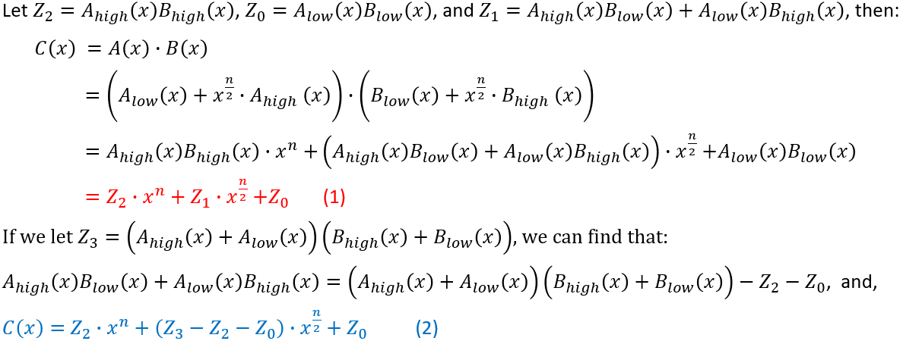
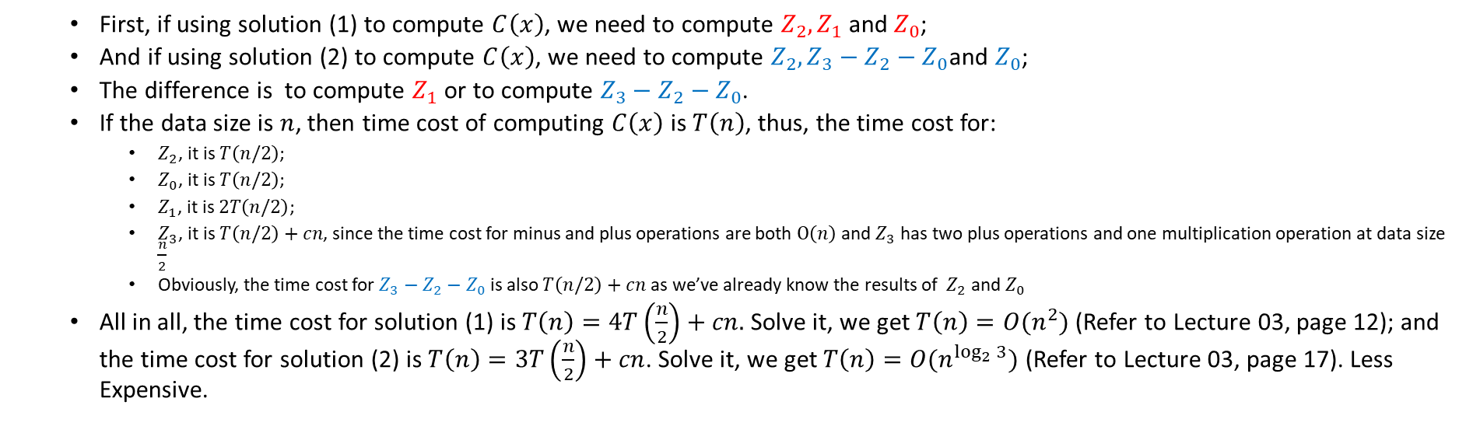
Algorithm Analysis
Think: why we use (2) to compute $C\left(x\right)$instead of (1)?
First, if using solution (1) to compute $C\left(x\right)$, we need to compute $Z_{2},Z_{1}$ and $Z_{0}$;
And if using solution (2) to compute $C\left(x\right)$, we need to compute $Z_{2},Z_{3}−Z_{2}−Z_{0}$and $Z_{0}$;
The difference is to compute $Z_{1}$ or to compute $Z_{3}−Z_{2}−Z_{0}$.
If the data size is $n$, then time cost of computing $C\left(x\right)$ is $T\left(n\right)$, thus, the time cost for:
$Z_{2}$, it is $T\left(n/2\right)$;
$Z_{0}$, it is $T\left(n/2\right)$;
$Z_{1}$, it is $2T\left(n/2\right)$;
$Z_{3}$, it is $T\left(n/2\right)+cn$, since the time cost for minus and plus operations are both $Ο\left(n\right)$ and $Z_{3}$ has two plus operations and one multiplication operation at data size $\frac{n}{2}$
Obviously, the time cost for $Z_{3}−Z_{2}−Z_{0}$ is also $T\left(n/2\right)+cn$ as we’ve already know the results of $Z_{2}$ and $Z_{0}$
All in all, the time cost for solution (1) is $T\left(n\right)=4T\left(\frac{n}{2}\right)+cn.$ Solve it, we get $T\left(n\right)=O(n^{2})$ (Refer to Lecture 03, page 12); and the time cost for solution (2) is $T\left(n\right)=3T\left(\frac{n}{2}\right)+cn$. Solve it, we get $T\left(n\right)=O(n^{\log_{2}{3}})$ (Refer to Lecture 03, page 17). Less Expensive.

Slide 4
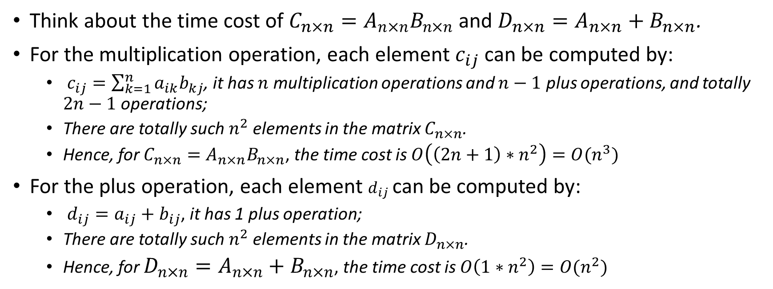
In-depth thinking
Think about the time cost of $C_{n×n}=A_{n×n}B_{n×n}$ and $D_{n×n}=A_{n×n}+B_{n×n}$.
For the multiplication operation, each element $c_{ij}$can be computed by:
$c_{ij}=\sum_{k=1}^{n}{a_{ik}b_{kj}}$, it has $n$ multiplication operations and $n−1$ plus operations, and totally $2n−1$ operations;
There are totally such $n^{2}$ elements in the matrix $C_{n×n}$.
Hence, for $C_{n×n}=A_{n×n}B_{n×n}$, the time cost is $O\left(\left(2n+1\right)∗n^{2}\right)=O(n^{3})$
For the plus operation, each element $d_{ij}$can be computed by:
$d_{ij}=a_{ij}+b_{ij}$, it has 1 plus operation;
There are totally such $n^{2}$ elements in the matrix $D_{n×n}$.
Hence, for $D_{n×n}=A_{n×n}+B_{n×n}$, the time cost is $O\left(1∗n^{2}\right)=O(n^{2})$

Slide 5
In-depth thinking
Conclusion
Regardless of whether it is polynomial multiplication or matrix multiplication, from the perspective of algorithm complexity, in subproblems, we prefer to reduce the scale of multiplication operations or convert multiplication operations into smaller-scale addition operations. (不管是多项式乘法还是矩阵乘法，从算法复杂度出发，在子问题中，我们更愿意减少乘法运算的规模，或者将乘法运算转化成规模更小的加法运算。)

Slide 6

For your reference
Actually, we can find a better $O(nlogn)$ solution to solve the polynomial multiplication by Fast Fourier Transform (FFT) algorithm.
Click here to watch the video if you’re interested in that.

